Slide 1
Declarative Programming Paradigm: Functional Programming
Module 3

Slide 2
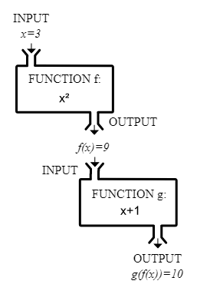
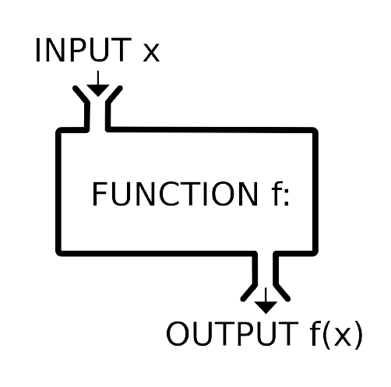
Functional Programming
Functional programming is style of programming in which the basic method of computation is the application of functions to arguments
constructed by applying and composing functions.
Expressions that map a set of values to another set of values
Results could be pipelined

Slide 3
Eg: In Java In Haskell
total = 0;
for (i = 1; i <= 10; ++i)
total = total+i;
sum [1..10]

Slide 4
Functional Programming
Pure functions (mathematical )
All computation are treated as evaluation of mathematical functions.
No/ less side effects
They remember no state. The state helps in tracking the values between function calls.
return value is the same for the same arguments ( for a given input, output is same)
No effect of local/ global values
Immutable
unable to change.
functional programs do not maintain state, the data they work with is immutable. we create values or objects by initializing them. If we need, we create a new one
Notes:
Immutable - https://medium.com/walmartglobaltech/demystifying-functional-programming-part-2-the-need-for-immutability-4f5c16ae2c9a
Side effects - https://dzone.com/articles/side-effects-1
Tutorial - https://www.youtube.com/watch?v=Vgu82wiiZ90

Slide 5
Declarative style
program logic is expressed without explicitly describing the flow control.
Imperative programs spend lines of code describing the specific steps used to achieve the desired results. The sequence is fixed
Functional programming does not have any interdependencies because it replaces the procedures with the pure functions that use the immutable state.
The usage of the pure functions creates a flexible environment where the code order depends on the underlying math.
Easy to verify
work a lot with guards, pattern matching and recursion which is simpler for an automated system to check than complex imperative code with nested loops, break statements and potentially not fully expressed logic
Eg: Haskell, Lisp, Racket, Erlang, and OCaml are some of Functional programming languages.
Notes:
Immutable - https://medium.com/walmartglobaltech/demystifying-functional-programming-part-2-the-need-for-immutability-4f5c16ae2c9a
Side effects - https://dzone.com/articles/side-effects-1
Tutorial - https://www.youtube.com/watch?v=Vgu82wiiZ90

Slide 6
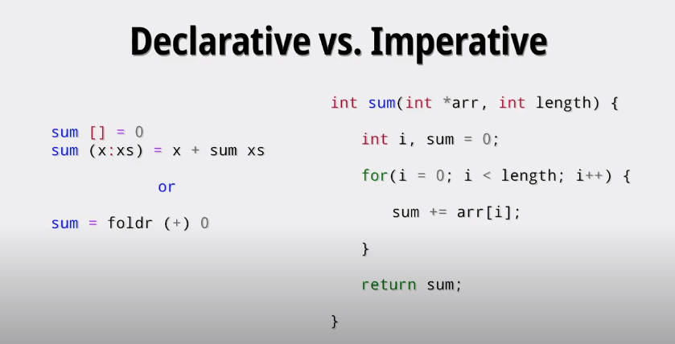

Slide 7

Haskell
A functional program is a single expression, which is executed by evaluating the expression.
Lazy evaluator
purely functional language, all computations are done via the evaluation of expressions (syntactic terms) to yield values (abstract entities that we regard as answers).
When functions are programmed in purely functional style, we do not focus on manipulating states and variables but on constants and functions.
capability to pass a function to another function as input. (higher-order functions)
uses the pure approach based on the lambda calculus principles.

Slide 8
Recursion is used for looping
Statically typed, need not mention the data type of variables
Type inference, need not define different versions of same function to deal with different data types
Concurrent, allows concurrent programming
Wide range of Packages
Shorter, clearer and more maintainable code. It is suitable for programs that need to be modified and maintained regularly.

Slide 9
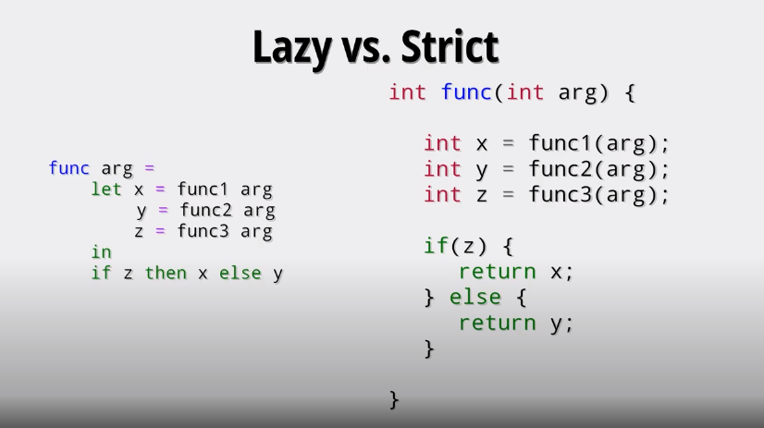

Slide 10
To execute Haskell
Interpreter - Hugs
cannot be used for compiling stand-alone programs.
It is used for testing and debugging programs in an interactive environment.
Compiler - GHC
compiler. It takes the code written in Haskell and then translates it into machine code.
Glasgow Haskell Compiler (GHC) is an interpreter and a compiler
It allows function definitions in the environment and implements Haskell 98 and extensions.

Slide 11
For Offline : Install haskell
https://www.haskell.org/platform/
Refer: shorturl.at/BDFT7
On Hugs Open cmd/ Terminal in VS Code
Type ghci to start ghc compiler
> ghci
Prelude>
^d to quit
Now you are ready to type haskell commands
For online command line:
https://tryhaskell.org/
https://repl.it/languages/haskell

Slide 12
To execute Haskell module ( @ interpreter - Hugs)
Step 1:
Open notepad or any other editor. Write code. Save with extension .hs
Eg:
main = putStrLn "Hello, World!"
Step 2: start ghci
Step 3: check current working directory
:show paths
Step4: Move path to the location where the file is saved, using cd command

Slide 13
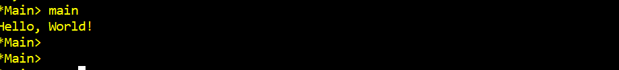
Step 5: load and compile
:load <filename.hs> or :l <filename.hs>
Stemp 6: <filename> ( use module name to execute)

Slide 14

To execute Haskell program ( @ command prompt MSDOS)
Step 1:
Open notepad or any other editor. Write code. Save with extension .hs
Eg:
main = putStrLn "Hello, World!"
Step 2: Go to the location where the file is saved using cd
Step 3: compile the haskell code
To obtain object file ( .o) and Executable file (.exe)

Slide 15





Step 4: Execute the code by calling the executable file ( executable file has the same name as the haskell file name)
To rename the executable file
Execute

Slide 16
What is a Type?
A type is a collection of related values.
Every expression and function have a type
Bool
The logical values
False and True.
Bool → Bool
All functions that map a logical value to a logical value.

Slide 17
Types in Haskell
Haskell is strongly typed, avoids errors. Does not convert int to float like in C
We use the notation e :: T to mean that evaluating the expression e will produce a value of type T.
False :: Bool
not :: Bool → Bool
not False :: Bool
False && True :: Bool

Slide 18
Note:
Every expression must have a valid type, which is calculated prior to evaluating the expression by a process called type inference;
Haskell programs are type safe, because type errors can never occur during evaluation;
Type inference detects a very large class of programming errors, and is one of the most powerful and useful features of Haskell.

Slide 19
Types

Slide 20
Basic Types
Haskell has a number of basic types, including:
Bool
- Logical values
Char
- Single characters
Fractional
- Real Numbers
String
- Strings of characters
Int
- Fixed-precision integers
Integer
- Arbitrary-precision integers ( unbounded,
expensive)

Slide 21
• :type True
• :type 5
• a = 4
• :type “hi”
• :type ‘h’
• :type 5.34 or :t 5.34

Slide 22
Basic operations in Haskell
Arithmetic and Logical
• 2 + 3
• 2 – 3
• 2 * 3
• 2 * (-3)
• 2 / 3
• it
• 50 * 100 - 4999
• 50 * (100 – 4999)
• 40*100-3000+50/5
• (40*100-3000+50)/5
• 2 + “hi”
• 1 + True
• True && False
• True && True
• False || True
• not False
• not (True && False)
• not (True || False)

Slide 23
Comparative operators
• 2 == 3
• 2 == 2
• 2 /= 2
• 2 /= 0
• 2 < 3
• 2 > 3
• 2 ^ 3
• not (2 < 3)
• “hi” == “hi”
• “hi” == “Hi”

Slide 24
Typeclasses
2) List Types
A list is sequence of values of the same type
Also called composite data type
[False,True,False] :: [Bool]
[’a’,’b’,’c’,’d’] :: [Char]
In general:
[T] is the type of lists with elements of type T.

Slide 25
Note:
The type of a list says nothing about its length:
[False,True] :: [Bool]
[False,True,False] :: [Bool]
The type of the elements is unrestricted. For example, we can have lists of lists:
[[’a’],[’b’,’c’]] :: [[Char]]

Slide 26
List
• [ ]
• [[]]
• [1,2,3,4]
• [“a”,”b”,”c”,”d”]
• [‘a’,’b’,’c’,’d’]
Range
• [‘a’..’z’]
• [’J’..’M’]
• [1..10]
• [0,2..10]
• [1,3..10]
• [‘a’,’c’..’z’]
• [2,4..10*2]
• take 10 [2,4..]
• take 10 [1,1..]
• take 10 [0,0..]
• replicate 5 2
• take 10 (cycle [1,2,3])
• take 10 (cycle “hi ”)

Slide 27
3) Tuple Types
A tuple is a sequence of values of different types
Also called composite data type
(False,True) :: (Bool,Bool)
(False,’a’,True) :: (Bool,Char,Bool)
In general:
(T1,T2,…,Tn) is the type of n-tuples whose ith components have type Ti for any i in 1…n.

Slide 28
Note:
The type of a tuple encodes its arity:
(False,True) :: (Bool,Bool)
(False,True,False) :: (Bool,Bool,Bool)
The type of the components is unrestricted:
(’a’,(False,’b’)) :: (Char,(Bool,Char))
(True,[’a’,’b’]) :: (Bool,[Char])

Slide 29
• (True, False)
• :type (True, False)
• (True, 5)
• :type (True, 5)

Slide 30
4) Function Types
A function is a mapping from values of one type to values of another type:
not :: Bool → Bool
isDigit :: Char → Bool
In general:
T1 → T2 is the type of functions that map arguments of type T1 to results of type T2.

Slide 31
Build in Functions
• sum [1,2,3]
• succ 6
• succ 7 * 8
• succ (7 * 8)
• min 4 9
• max 4 9
• div 4 3
• div 3 4
• 4/3
• mod 3 2
• reverse “hello”
• x = 45
print x
• return True
• x <- return 35
• y = return 35
• print y
• putStrLn "hello“
• putStr "hello“

Slide 32
Lists Comprehensions

Slide 33
Lists Comprehensions
In Haskell, a similar comprehension notation can be used to construct new lists from old lists.
[x^2 | x ← [1..5]]
The list [1,4,9,16,25] of all numbers x^2 such that x is an element of the list [1..5].

Slide 34
Note:
The expression x ← [1..5] is called a generator, as it states how to generate values for x.
Comprehensions can have multiple generators, separated by commas. For example:
[(x,y) | x ← [1..3], y ← [1..2]]
[(1,1),(1,2),(2,1),(2,2),(3,1),(3,2)]

Slide 35
• xs = [1,2,3,4]
• ys = [5,6,7,8]
• zs = ys++[0]
• 0:xs
• ys ++ [5]
• xs !! 3
• head xs
• tail xs
• init xs
• last xs
• take 3 [1,2,3,4,5]
• drop 3 xs
• null [1,2,3,4,5]
• minimum [1,2,3,4]
• maximum [1,2,3,4]
• sum xs
• product xs
• length xs
• reverse xs
• map odd xs
• 6 `elem` [3,4,5,6]
• filter odd xs
• filter even xs
• filter (\xs -> sqrt xs >= 2) xs
• let (ys,zs) = splitAt 1 xs in ys ++ [9] ++ zs
• let (ys,zs) = splitAt 1 a in ys ++ (tail zs)
Notes:
http://learnyouahaskell.com/starting-out

Slide 36
Changing the order of the generators changes the order of the elements in the final list:
> [(x,y) | y ← [1..2], x ← [1..3]]
[(1,1),(2,1),(3,1),(1,2),(2,2),(3,2)]
Multiple generators are like nested loops, with later generators as more deeply nested loops whose variables change value more frequently.

Slide 37
Dependant Generators
Later generators can depend on the variables that are introduced by earlier generators.
[(x,y) | x ← [1..3], y ← [x..3]]
The list [(1,1),(1,2),(1,3),(2,2),(2,3),(3,3)]
of all pairs of numbers (x,y) such that x,y are elements of the list [1..3] and x ≤ y.

Slide 38
Using a dependant generator we can define the library function that concatenates a list of lists:
concat :: [[a]] → [a]
concat xss = [x | xs ← xss, x ← xs]
For example:
> concat [[1,2,3],[4,5],[6]]
[1,2,3,4,5,6]

Slide 39
• [x*2 | x <- [1..10]]
• [x*2 | x <- [1..100], x `mod` 2 == 0]
• [ x | x <- [10..20], x /= 13, x /= 15, x /= 17]
• [x | x <- [1..100], x `mod` 7 == 0, x >= 50]
• [x^2 | x <- [1..10]]
• [2^x | x <- [1..10]]
• [ c| c <- “Hahaha! Ahahaha!", c `elem` ['A'..'Z']]
3 + 4 infix 6 `mod` 4
3 4 prefix mod 6 2 ( default)

Slide 40
How to write a Haskell program
Refer example given in drive

Slide 41
Functions
name arg1 arg2 … argn = <expr>
No parentheses
No commas
To call
name arg1 arg2 … argn
No return but the evaluation of expression is returned
Argument list
Module name
This is what function returns, definition of the function
Eg:
double n = 2*n
double 4
=> 8

Slide 42
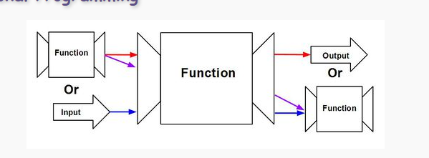

Slide 43
In mathematics, function application is denoted using parentheses, and multiplication is often denoted using juxtaposition or space.
f(a,b) + c d
Apply the function f to a and b, and add the result to the product of c and d.

Slide 44
In Haskell, function application is denoted using space, and multiplication is denoted using *.
f a b + c*d
As previously, but in Haskell syntax.

Slide 45
Moreover, function application is assumed to have higher priority than all other operators.
f a + b
Means (f a) + b, rather than f (a + b).

Slide 46
Mathematics
Haskell
f(x)
f x
f(x,y)
f x y
f(g(x))
f (g x)
f(x,g(y))
f x (g y)
f(x)g(y)
f x * g y

Slide 47
Function Types
A function is a mapping from values of one type to values of another type:
not :: Bool → Bool
isDigit :: Char → Bool
In general:
T1 → T2 is the type of functions that map arguments of type T1 to results of type T2.

Slide 48
Note:
The argument and result types are unrestricted. For example, functions with multiple arguments or results are possible using lists or tuples:
add :: (Int,Int) → Int // OR add :: Int→Int → Int
add (x,y) = x+y //OR add x y = x+y
zeroto :: Int → [Int]
zeroto n = [0..n]

Slide 49
Polymorphic Types
The function length calculates the length of any list, irrespective of the type of its elements.
polymorphism basically means that there is one algorithm for different types of operands
> length [1,3,5,7]
4
> length ["Yes","No"]
2
> length [isDigit,isLower,isUpper]
3

Slide 50
This idea is made precise in the type for length by the inclusion of a type variable:
length :: [a] → Int
For any type a, length takes a list of values of type a and returns an integer.
A type with variables is called polymorphic.

Slide 51
Note:
Many of the functions defined in the standard prelude are polymorphic. For example:
fst :: (a,b) → a
head :: [a] → a
take :: Int → [a] → [a]
zip :: [a] → [b] → [(a,b)]

Slide 52
Functions can defined with
Conditional Expression
Pattern matching
Guards

Slide 53
Conditional Expressions
As in most programming languages, functions can be defined using conditional expressions.
abs :: Int → Int
abs n = if n ≥ 0 then n else -n
abs takes an integer n and returns n if it is non-negative and -n otherwise.

Slide 54
Conditional expressions can be nested:
signum :: Int → Int
signum n = if n < 0 then -1 else
if n == 0 then 0 else 1
Note:
In Haskell, conditional expressions must always have an else branch, which avoids any possible ambiguity problems with nested conditionals.

Slide 55
Guarded Equations
As an alternative to conditionals, functions can also be defined using guarded equations.
abs n | n ≥ 0 = n
| otherwise = -n
As previously, but using guarded equations.

Slide 56
Guarded equations can be used to make definitions involving multiple conditions easier to read:
signum n | n < 0 = -1
| n == 0 = 0
| otherwise = 1
Note:
The catch all condition otherwise is defined in the prelude by otherwise = True.

Slide 57
Using a guard we can define a function that maps a positive integer to its list of factors:
factors :: Int → [Int]
factors n = [x | x ← [1..n]
, n `mod` x == 0]
For example:
> factors 15
[1,3,5,15]

Slide 58
A positive integer is prime if its only factors are 1 and itself. Hence, using factors we can define a function that decides if a number is prime:
prime :: Int → Bool
prime n = factors n == [1,n]
For example:
> prime 15
False
> prime 7
True

Slide 59
Using a guard we can now define a function that returns the list of all primes up to a given limit:
primes :: Int → [Int]
primes n = [x | x ← [1..n], prime x]
For example:
> primes 40
[2,3,5,7,11,13,17,19,23,29,31,37]

Slide 60
Pattern Matching
Many functions have a particularly clear definition using pattern matching on their arguments.
not :: Bool → Bool
not False = True
not True = False
not maps False to True, and True to False.

Slide 61
Functions can often be defined in many different ways using pattern matching. For example
(&&) :: Bool → Bool → Bool
True && True = True
True && False = False
False && True = False
False && False = False
can be defined more compactly by
True && True = True
_ && _ = False

Slide 62
However, the following definition is more efficient, as it avoids evaluating the second argument if the first argument is False:
False && _ = False
True && b = b
Note:
The underscore symbol _ is the wildcard pattern that matches any argument value.

Slide 63
In functional programming we never seem to define intermediate variables.
All the expressions we use come from the patterns of the arguments.
Haskell doesn’t technically have “variables”, because expressions never change their value!
But we can still define sub-expressions within our functions.
Notes:
https://mmhaskell.com/liftoff/syntax

Slide 64

Iteration
functional languages don't have loops!
The whole point of a loop is to repeat something until some condition no longer holds, but because functional programs don't have any variables, a condition's value can't change.
Solution is Recursion
recursion is the most important technique for iteration in functional languages.
Haskel code
fact n | n == 0 = 1
| otherwise = n * fact (n - 1)

Slide 65
Haskell provides a different way of defining functions called patterns.
Here, we write multiple definitions of the function, but each time using a different pattern for the arguments.
fact 0 = 1
fact n = n * fact (n - 1)

Slide 66
List Patterns
In Haskell, every non-empty list is constructed by repeated use of an operator : called “cons” that adds a new element to the start of a list.
[1,2,3]
Means 1:(2:(3:[])).

Slide 67
The cons operator can also be used in patterns, in which case it destructs a non-empty list.
head :: [a] → a
head (x:_) = x
tail :: [a] → [a]
tail (_:xs) = xs
head and tail map any non-empty list to its first and remaining elements.

Slide 68
Recursive Functions
In Haskell, functions can also be defined in terms of themselves. Such functions are called recursive.
factorial 0 = 1
factorial n = n * factorial (n-1)
factorial maps 0 to 1, and any other integer to the product of itself with the factorial of its predecessor.

Slide 69
For example:
factorial 3
=
3 * factorial 2
=
3 * (2 * factorial 1)
=
3 * (2 * (1 * factorial 0))
=
3 * (2 * (1 * 1))
=
3 * (2 * 1)
=
3 * 2
=
6

Slide 70
Why is Recursion Useful?
Some functions, such as factorial, are simpler to define in terms of other functions;
In practice, however, most functions can naturally be defined in terms of themselves;
Properties of functions defined using recursion can be proved using the simple but powerful mathematical technique of induction.

Slide 71
Recursion on Lists
Recursion is not restricted to numbers, but can also be used to define functions on lists.
product :: [Int] → Int
product [] = 1
product (x:xs) = x * product xs
product maps the empty list to 1, and any non-empty list to its head multiplied by the product of its tail.

Slide 72
For example:
product [1,2,3]
=
product (1:(2:(3:[])))
=
1 * product (2:(3:[]))
=
1 * (2 * product (3:[]))
=
1 * (2 * (3 * product []))
=
1 * (2 * (3 * 1))
=
6

Slide 73
head :: [a] -> a
head [] = []
head (x:_) = x
tails' :: [a] -> [[a]]
tails' [] = []
tails' (x:xs) = xs : tails' xs
len' :: [a] -> Integer
 | len' [] = 0
 | len' (_:xs) = 1 + len' xs

Slide 74
Higher order functions
A function is called higher-order if it takes a function as an argument or returns a function as a result.
twice :: (a → a) → a → a
twice f x = f (f x)
twice is higher-order because it
takes a function as its first argument.

Slide 75
Why Are They Useful?
Common programming idioms, such as applying a function twice, can naturally be encapsulated as general purpose higher-order functions;
Special purpose languages can be defined within Haskell using higher-order functions, such as for list processing, interaction, or parsing;
Algebraic properties of higher-order functions can be used to reason about programs.

Slide 76
The Map Function
The higher-order library function called map applies a function to every element of a list.
map :: (a → b) → [a] → [b]
For example:
> map (+1) [1,3,5,7]
[2,4,6,8]

Slide 77
The map function can be defined in a particularly simple manner using a list comprehension:
map f xs = [f x | x ← xs]
Alternatively, for the purposes of proofs, the map function can also be defined using recursion:
map f [] = []
map f (x:xs) = f x : map f xs

Slide 78
The Filter Function
The higher-order library function filter selects every element from a list that satisfies a predicate.
filter :: (a → Bool) → [a] → [a]
For example:
> filter even [1..10]
[2,4,6,8,10]

Slide 79
Filter can be defined using a list comprehension:
filter p xs = [x | x ← xs, p x]
Alternatively, it can be defined using recursion:
filter p [] = []
filter p (x:xs)
| p x = x : filter p xs
| otherwise = filter p xs

Slide 80
The Foldr Function
A number of functions on lists can be defined using the following simple pattern of recursion:
f [] = v
f (x:xs) = x ⊕ f xs
f maps the empty list to a value v, and any non-empty list to a function ⊕ applied to its head and f of its tail.

Slide 81
For example:
sum [] = 0
sum (x:xs) = x + sum xs
^{v} = 0
⊕ = +
product [] = 1
product (x:xs) = x * product xs
^{v} = 1
⊕ = *
and [] = True
and (x:xs) = x && xs
^{v} = True
⊕ = &&

Slide 82
The higher-order library function foldr (“fold right”) encapsulates this simple pattern of recursion, with the function ⊕ and the value v as arguments.
For example:
sum = foldr (+) 0
product = foldr (*) 1
and = foldr (&&) True

Slide 83
Foldr itself can be defined using recursion:
foldr (⊕) v [] = v
foldr (⊕) v (x:xs) =
x ⊕ foldr (⊕) v xs
In practice, however, it is better to think of foldr non-recursively, as simultaneously replacing each
cons in a list by a function, and [] by a value.

Slide 84
For example:
sum [1,2,3]
=
foldr (+) 0 [1,2,3]
=
foldr (+) 0 (1:(2:(3:[])))
=
1+(2+(3+0))
=
6
Replace each cons
by + and [] by 0.

Slide 85
Why Is Foldr Useful?
Some recursive functions on lists, such as sum, are simpler to define using foldr;
Properties of functions defined using foldr can be proved using algebraic properties of foldr, such as fusion and the banana split rule;
Advanced program optimisations can be simpler if foldr is used in place of explicit recursion.

Slide 86
...where …. Clause
Is inbuilt function that can be used at runtime to generate a desired output
It can be very helpful when function calculation becomes complex.
mathCalc:: Int -> Int -> Int -> Int
mathCalc x y z = diff1 + diff2 + prod + x
where
prod = diff2 * x * y
diff1 = y - z
diff2 = z - diff1

Slide 87
mathFunction :: Int -> Int -> Int -> Int
mathFunction a b c = diff1 + diff2 + prod + a
where
diff1 = c - diff2
diff2 = b - diff1
prod = a * b * c
????

Slide 88
let ...in…. Clause
Similar syntactic construct like where
Except we declare the new expressions beforehand. We then have to use the keyword in to signal the expression that will use the values.
mathFunction :: Int -> Int -> Int -> Int
mathFunction a b c =
let diff1 = c - a
diff2 = b - a
prod = a * b * c
in diff1 + diff2 + prod + a
Notes:
https://wiki.haskell.org/Let_vs._Where
https://www.educba.com/haskell-let/

Slide 89
Infix and prefix functions
Functions in Haskell are usually called using prefix notation, or the function name followed by its arguments.
In Haskell, binary operators such as + and * are functions, too they are used differently in that their names are placed between the two arguments (infix notation) rather than before them (prefix notation).
17 + 25
(+) 1 2

Slide 90
Haskell has two categories of functions:
functions whose names consist solely of symbols (like +), invoked using infix notation
Section : (Negation (as in −x) is the sole exception to the rule that all symbolic names are infix operators.
functions whose names consist solely of letters (like sqrt),invoked using prefix notation or infix
zip [1,2] ['a','b']
[1,2] `zip` ['a','b']

Slide 91
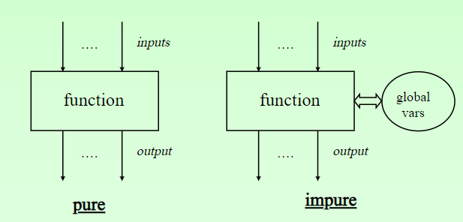
Lambda Calculus
Functions take input and give an output
Functions are black boxes
The Turing Machine according to the
Theory of Computation, with functions are
implemented with states
But, in pure functions of lambda calculus, functions have no internal state
They are pure mathematical statements
So, how define functions in Lambda Calculus
λx . x+1
input output
λx.λy.x+y
input output
input output

Slide 92
Is formal system in mathematical logic for expressing computation
It captures and represents FUNCTIONS, PARAMETERS, VALUES and CALCULATION via APPLICATIONS
Programs ---->collect , modify and transmit data
Consisting of values, arguments and function
Lambda calculus describes function with Lambda expressions
\(head).(body)
λ a backslash character (\) pronounced lambda
Head holds function parameter, Body describes what is returned by the function
Eg \a b.a*3 +b \b. b

Slide 93
Why lambda calculus?
Can encode any computational statement
Basis for functional programming language
Is adopted by most programming languages ( Java, C sharp)
But lambda calculus has
No datatypes, recursion etc
So the lamba statements need to be encoded

Slide 94
Encode logical NOT
Let
TRUE = λx . λy.x
FALSE= λx . λy.y
Then NOT is defined as
NOT = λb .b FALSE TRUE
Check
NOT TRUE
(λb .b FALSE TRUE) TRUE
TRUE FALSE TRUE
(λx . λy.x) FALSE TRUE
FALSE

Slide 95
Lambda Expressions
A function can be constructed without giving it a name (anonymous) by using a lambda expression.
λx → x+1
The nameless function that takes a number x and returns the result x+1.

Slide 96
Lambda expressions is use full in write anonymous functions that can be used to avoid giving names to the helper functions.
Anonymous functions are known as “lambda” functions.
They are introduced with a backslash character (\) pronounced lambda
lambda is followed by the function’s arguments and then an arrow (->) to introduce the function’s body.
compose f g x = f (g x)
is more naturally defined by
compose f g = λx → f (g x)

Slide 97
Lambda expressions can be applied to arguments
(\a.a)3 becomes \3.3 gives 3
Try
(\x -> 3*x)2
map (\x -> 3*x) [1,2,5,7,9]

Slide 98
Curried Functions
Functions with multiple arguments are also possible by returning functions as results:
add’ :: Int → (Int → Int)
add’ x y = x+y
add’ takes an integer x and returns a function. In turn, this function takes an integer y and returns the result x+y.

Slide 99
Note:
add and add’ produce the same final result, but add takes its two arguments at the same time, whereas add’ takes them one at a time:
add :: (Int,Int) → Int
add’ :: Int → (Int → Int)
Functions that take their arguments one at a time are called curried functions.

Slide 100
Functions with more than two arguments can be curried by returning nested functions:
mult :: Int → (Int → (Int → Int))
mult x y z = x*y*z
mult takes an integer x and returns a function, which in turn takes an integer y and returns a function, which finally takes an integer z and returns the result x*y*z.

Slide 101
Why curried functions?
Inputs to functions can be given later
add x y=x+y
map (add 1) [1,2,3]
Curried function takes parameters one at a time
Here add is a general purpose function
Lambda expression
add x = \y -> x+y
add = \x ->( \y -> x+y)

Slide 102
Evaluation order
Do not evaluate an expression unless its value is needed
Avoids repeated evaluations, referred to as Lazy evaluation ( contrast to eager / strict evaluation)
Performance increases by avoiding needless calculations,ensures early termination whenever possible
Supports programs with infinite lists
Allows programs to be more modular
Lazy evaluation is often combined with memoization
optimization technique used primarily to speed up computer programs by storing the results of expensive function calls and returning the cached result when the same inputs occur again.

Slide 103
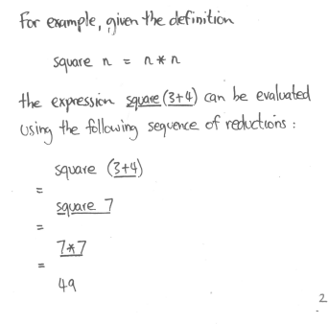
Expression is evaluated or reduced by successfully applying the definition until no further simplification is possible

Slide 104
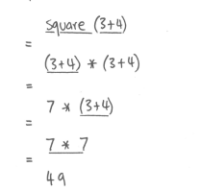
Also there could another possible reduction
In Haskell Different ways of evaluation always gives same result

Slide 105
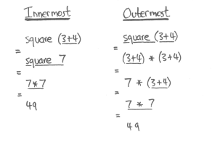
Reduction Strategy
Common strategy for redex ( reducible subexpression)
Innermost reduction
Outermost reduction
The outermost is inefficient - duplication in calculations

Slide 106
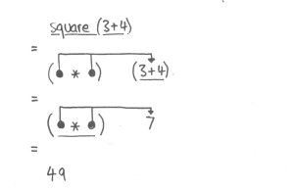
The problem can be solved using pointer to indicate sharing of evaluation
This gives rise to new reduction strategy
Lazy evaluation = outermost evaluation + sharing

Slide 107
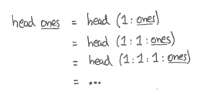


Innermost Lazy Evaluation
Does not terminate terminates
Using lazy evaluation only the first value in the list ones is produced, since it is all that is required
Lazy evaluation allows us to make the program more modular
By separating the control and data
take 5 ones
Notes:
https://doisinkidney.com/posts/2018-11-10-a-very-simple-prime-sieve.html

Slide 108
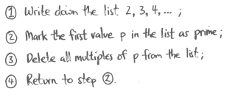
Example: sieve of Eratosthenes.
Solution:
primes = sieve [2..]
sieve (p:ps) = p : sieve [ x | x <- ps, mod x p /= 0 ]
Demo https://doisinkidney.com/posts/2018-11-10-a-very-simple-prime-sieve.html
Notes:
https://www.storyofmathematics.com/sieve-of-eratosthenes

Slide 109
Lazy evaluation:
reduces arguments only if used, but at most once
essentially, an efficient implementation of normal order reduction
corresponds to “call by need” parameter passing scheme

Slide 110
I/O Stream
To date, we have seen how Haskell can be used to write batch programs that take all their inputs at the start and give all their outputs at the end.
inputs
batch
program
outputs

Slide 111
However, we would also like to use Haskell to write interactive programs that read from the keyboard and write to the screen, as they are running.
keyboard
inputs
interactive
program
outputs
screen

Slide 112
The Problem
Haskell programs are pure mathematical functions:
Haskell programs have no side effects. ( same i/p => same o/p
Lazy evaluation
However, reading from the keyboard and writing to the screen are side effects:
Interactive programs have side effects.

Slide 113
The Solution
Interactive programs can be written in Haskell by using types to distinguish pure expressions from impure actions that may involve side effects.
type IO a are descriptions of effectful computations, which, if executed would (possibly) perform some effectful I/O operations and (eventually) produce a value of type a
The type of actions that return a value of type a.
IO a
Notes:
https://www.seas.upenn.edu/~cis194/fall16/lectures/06-io-and-monads.html

Slide 114
For example:
The type of actions that return a character.
IO Char
The type of purely side effecting actions that return no result value.
IO ()

Slide 115
Note:
() is the type of tuples with no components.
main :: IO ()
Every line of do return IO()
<- extracts the value from IO()
IO is for doing IO related actions

Slide 116
Primitive Actions
The standard library provides a number of actions, including the following three primitives:
The action getChar reads a character from the keyboard, echoes it to the screen, and returns the character as its result value:
getChar :: IO Char

Slide 117
The action putChar c writes the character c to the screen, and returns no result value:
putChar :: Char → IO ()
The action return v simply returns the value v, without performing any interaction:
return :: a → IO a

Slide 118
IO Functions
print
putStr
putStrLn
writeFile
appendFile
getLine
getChar
readFile
Return
get2Line
Show
read

Slide 119
Sequencing Actions
A sequence of actions can be combined as a single composite action using the keyword do.
For example:
getTwo :: IO (Char,Char)
getTwo = do x ← getChar
y ← getChar
return (x,y)

Slide 120
Note - in a sequence of actions:
Each action must begin in precisely the same column. That is, the layout rule applies;
The values returned by intermediate actions are discarded by default, but if required can be named using the ← operator;
The value returned by the last action is the value returned by the sequence as a whole.

Slide 121
Other Library Actions
Reading a string from the keyboard:
getLine :: IO String
getLine = do x ← getChar
if x == '\n' then
return []
else
do xs ← getLine
return (x:xs)

Slide 122
Writing a string to the screen:
putStr :: String → IO ()
putStr [] = return ()
putStr (x:xs) = do putChar x
putStr xs
Writing a string and moving to a new line:
putStrLn :: String → IO ()
putStrLn xs = do putStr xs
putChar '\n'

Slide 123
Example
We can now define an action that prompts for a string to be entered and displays its length:
strlen :: IO ()
strlen = do putStr "Enter a string: "
xs ← getLine
putStr "The string has "
putStr (show (length xs))
putStrLn " characters"

Slide 124
For example:
> strlen
Enter a string: hello there
The string has 11 characters
Note:
Evaluating an action executes its side effects, with the final result value being discarded.

Slide 125
I/O in Haskell
Functions in haskell are Pure functions
No side effects
Lazy evaluation

Slide 126
File Handling
Haskell defines some basic functions for I/O that are listed in the System.IO library.
One common function is openFile that provides a file Handle.
This Handle is then used to perform some operations on the file.
Haskell also provides functions, such as hPutStrLn, which is similar to putStrLn, but takes an additional argument a Handle that specifies the files.
To close the Handle, use hClose.
Notes:
https://livebook.manning.com/book/get-programming-with-haskell/chapter-24/20

Slide 127
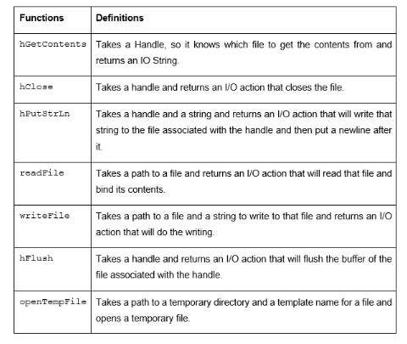

Slide 128
Combining IO
Sequencing
(>>) operator (pronounced “and then”)
creates an IO computation which consists of running the two input computations in sequence. Notice that the result of the first computation is discarded; we only care about it for its effects.
Tupling
his works fine for code of the form “do this; do this; do this” where the results don’t really matter.
(>>) :: IO a -> IO b -> IO b
IO a -> IO b -> IO (a,b)

Slide 129
Bind
It takes a computation which will produce a value of type a, and a function which gets to compute a second computation based on this intermediate value of type a. The result of (>>=) is a (description of a) computation which performs the first computation, uses its result to decide what to do next, and then does that.
main :: IO ()
main = putStrLn "Please enter a number: " >>
readLn >>= \n ->
let m = n + 1 in
putStrLn (show m)
(>>=) :: IO a -> (a -> IO b) -> IO b

Slide 130
One key feature of Haskell is that it is a purely functional language. Functions are pure.
But Haskell still has "impure" functions for IO. In Haskell pure and impure functions are kept apart, by using the IO type to mark "impure" functions.
You can never hide the fact that IO is used somewhere inside a large program.
You can get access to the result of an IO operation inside a do block,
then apply pure functions to it, but the whole do block has type IO

Slide 131
Monads
monad is handy whenever a programmer wants to sequence actions

Slide 132
References
Text Book :
Graham Hutton, Programming in Haskell, 2nd Edition, Cambridge University Press 2016. ( No complete ebook, find 2 chapter @ http://www.cs.nott.ac.uk/~pszgmh/pih.html#contents
Also find some reference here, https://www.book2look.com/vbook.aspx?id=9781316626221 )
Scott M L, Programming Language Pragmatics, 3rd Edn., Morgan Kaufmann Publishers, 2009 [Chapter 10]
Online resources
https://downloads.haskell.org/~ghc/7.8.4/docs/html/users_guide/
http://learnyouahaskell.com/introduction
http://users.umiacs.umd.edu/~hal/docs/daume02yaht.pdf
https://www.cmi.ac.in/~madhavan/courses/pl2009/lecturenotes/lecture-notes/node70.html

